Slide 1
Using images for teaching cheryl goldenstein & jennifer mayer 9/28/09
e-volution

Slide 2
Overview
Why use images in teaching?
When to use images
Sources for images
Issues and challenges of image use
Expectations for students using images

Slide 3
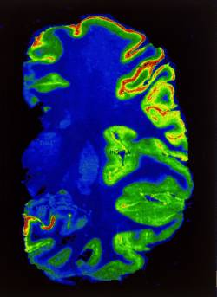
Why use images in teaching?
Today’s learners are visual
Research: picture superiority effect (Paivio, 1990; Kosslyn, 1981; Nelson, 1979)
Text + images = learning. Pick your theory:
Dual code processing
Left brain/right brain
Multiple intelligences
Preferred learning styles
Cognitive load theory

Slide 4
Images may be used to . . .
Add visual appeal (decoration)
Add emotional impact or humor
Communicate information concisely
Illustrate a concept
Promote critical thinking

Slide 5
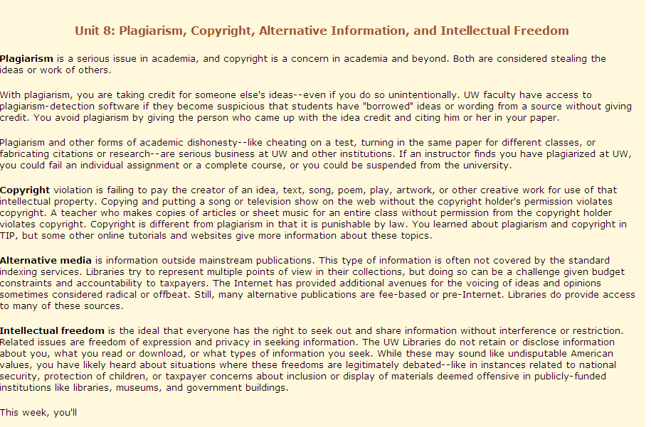
Adding visual appeal
vs.

Slide 6
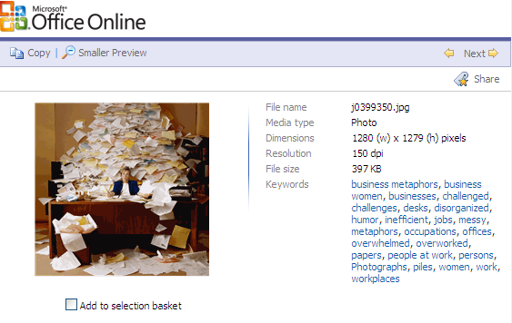
Freebies from Microsoft
Lots of tags for searching

Slide 7
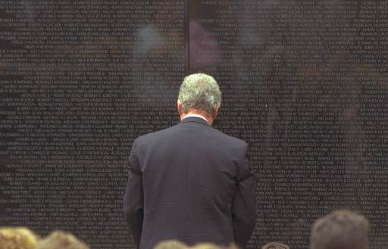
Adding emotion
President Clinton pauses at the Vietnam Veterans Memorial in Washington, Monday, May 31, 1993, after giving a Memorial Day Speech at the Wall. (AP Photo/Ron Edmonds)

Slide 8
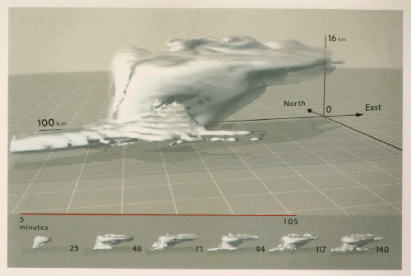
Communicate information concisely
Flowcharts
Illustrations
Maps
Information design: Tufte (1983, 1991, 1997, 2006)
Notes:
Tufte here and charts easier to read

Slide 9
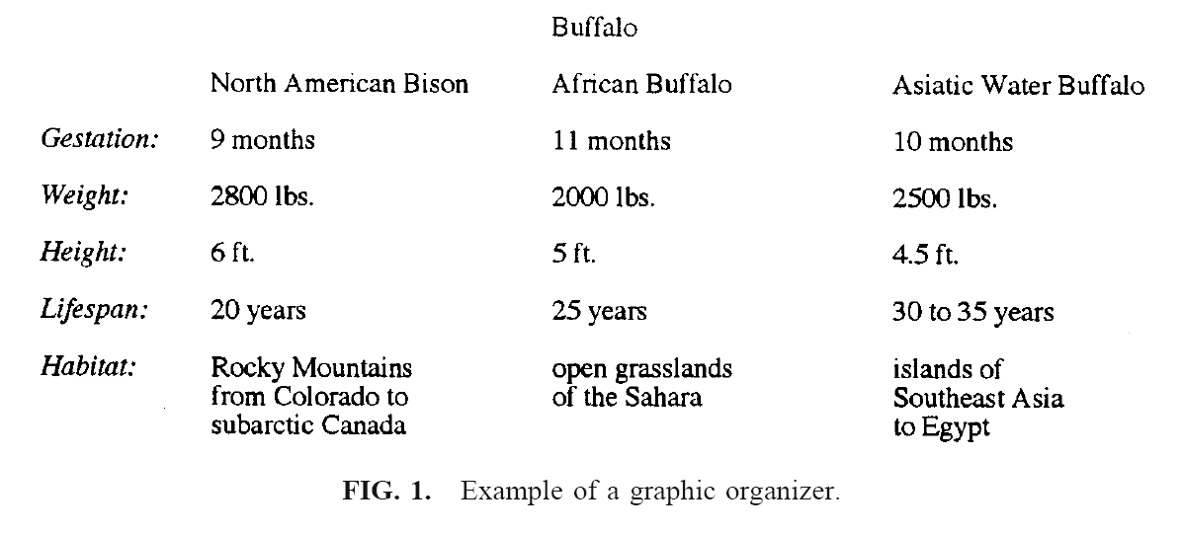
Text as a “picture”
Robinson, D.H., Robinson, S.L., & Katayama, A.D. (1999). When words are represented in memory like pictures: evidence for spatial encoding of study materials. Contemporary Educational Psychology, 24, 38-54.

Slide 10
Illustrate a concept Dorito Polyhedron, Tim Hawkinson, 1991, ARTstor

Slide 11
Other ways to illustrate concepts:
Flow charts
Diagrams
Charts
Animations
Photographs

Slide 12
ENIAC computer 1/1/46, University of Pennsylvania, AP Images

Slide 13
Critical thinking The Seamstress, Kenneth Martin, 1854-8

Slide 15
Irene Smirnova, of Moscow, top, dangles her feet from a bridge over the Charles River, in Cambridge, Mass., as people row along on the water below on the last day of summer, Monday, Sept. 21, 2009. (AP Photo/Steven Senne)

Slide 16
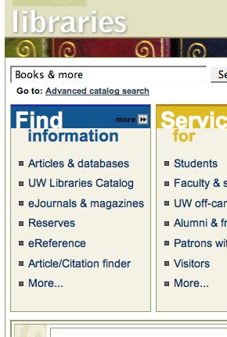
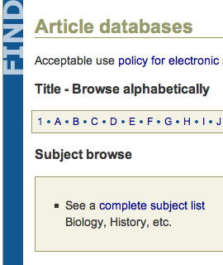
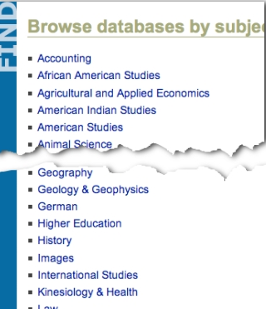
Finding Images
Notes:
JM starts here

Slide 17
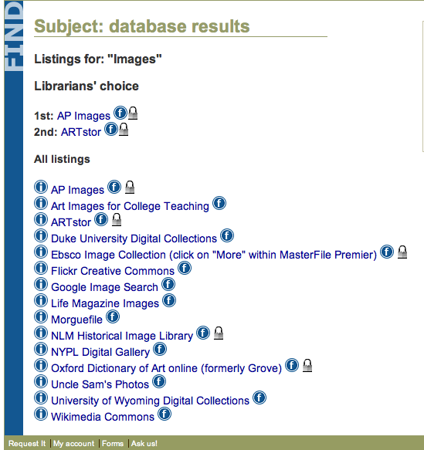
UW Libraries Image Databases
AP Images
ARTstor
Ebsco Images

Slide 18
UW image databases
UW Libraries homepage
http://www-lib.uwyo.edu

Slide 19
Open access sites
Wikimedia Commons: http://commons.wikimedia.org
Flickr http://www.flickr.com/creativecommons/
Digital collections, Wyoming-related
http://digital.uwyo.edu/
Boston U. Library images on the web:
http://www.bu.edu/library/instruction/findimages/

Slide 20
Keep in mind
Quality
Copyright
http://www.bu.edu/library/instruction/findimages/copyright.html

Slide 21
Examples of student projects
Poster sessions, variety of disciplines
Assignment to find a specific image
Analyzing advertisement images
Analyzing social justice posters
Powerpoints
Others?

Slide 22
Questions?
Cheryl Goldenstein cgold@uwyo.edu
Jennifer Mayer mayerj@uwyo.edu

Slide 23
References/recommended reading
Heinich, Robert, et. al. Instructional Media and the New Technologies of Instruction, 1982.
Lohr, Linda L. Creating Graphics for Learning and Performance, 2003.
Mayer, Jennifer and Cheryl Goldenstein. “Academic Libraries Supporting Visual Culture: A Survey of Image Access and Use.” Art Documentation 28.1 (Spring 2009): 16-28.
Tufte, Edward R. Envisioning Information, 1990.

